Slide 1

Lecture 15:
GUIs and Executables
CoTaPP: Computational Thinking and
Programming with Python
All icons by: https://www.flaticon.com/

Slide 2

Exam Review
Online
Check exam: remindo
Today, 14:00 – 16:00
  You need to start the review between 14:00 to 15:00
  60 minutes to review your exam
Questions? On Teams
  Isaac
  Pablo

Slide 3
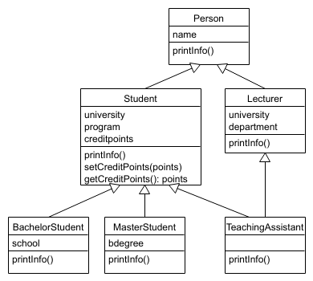
Previous lecture
Object-oriented programming (OOP)

Slide 4



Slide 5

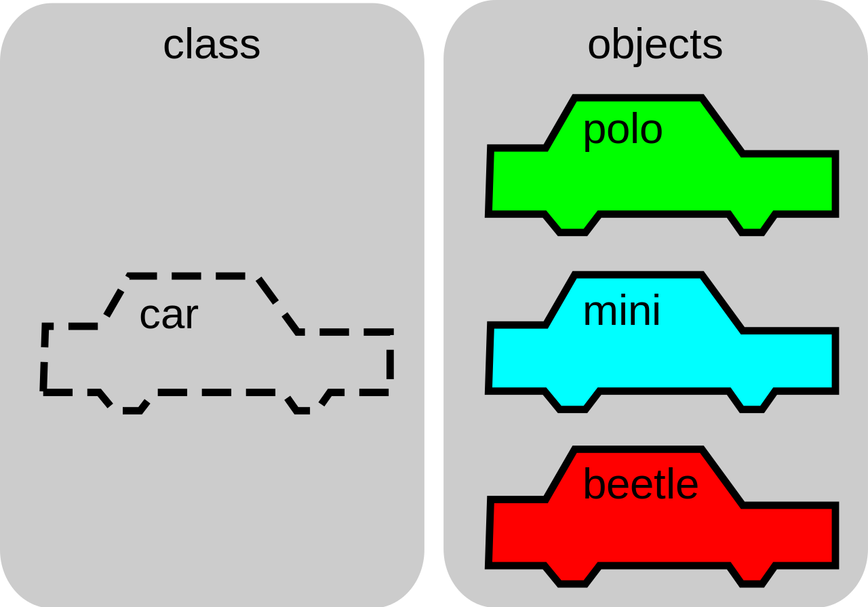
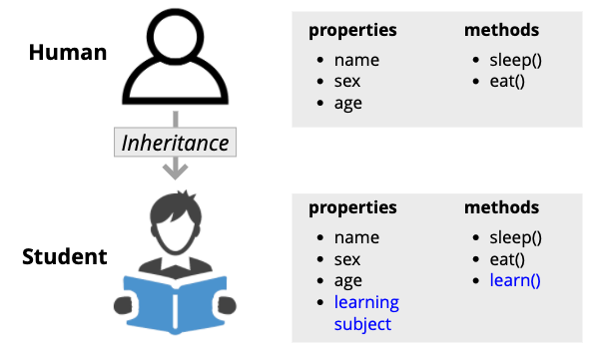

Slide 6
Today’s lecture
Building
  graphical user interfaces (GUIs)
  executables

Slide 7
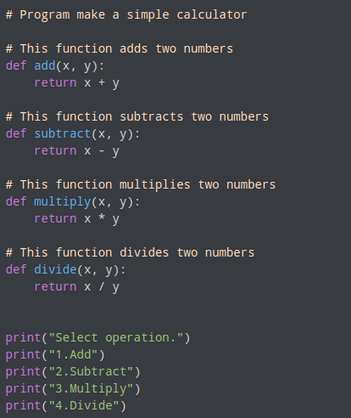
Graphical User Interfaces (GUIs)

Slide 8
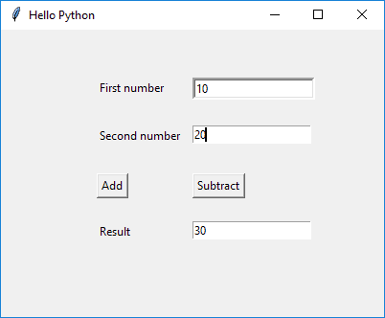
Graphical User Interfaces (GUIs)

Slide 9
Graphical User Interfaces (GUIs)
Large number of frameworks and toolkits available for building GUIs in Python
  https://wiki.python.org/moin/GuiProgramming
We are going to use Tkinter
  easy-to-use standard GUI framework included in Python

Slide 10
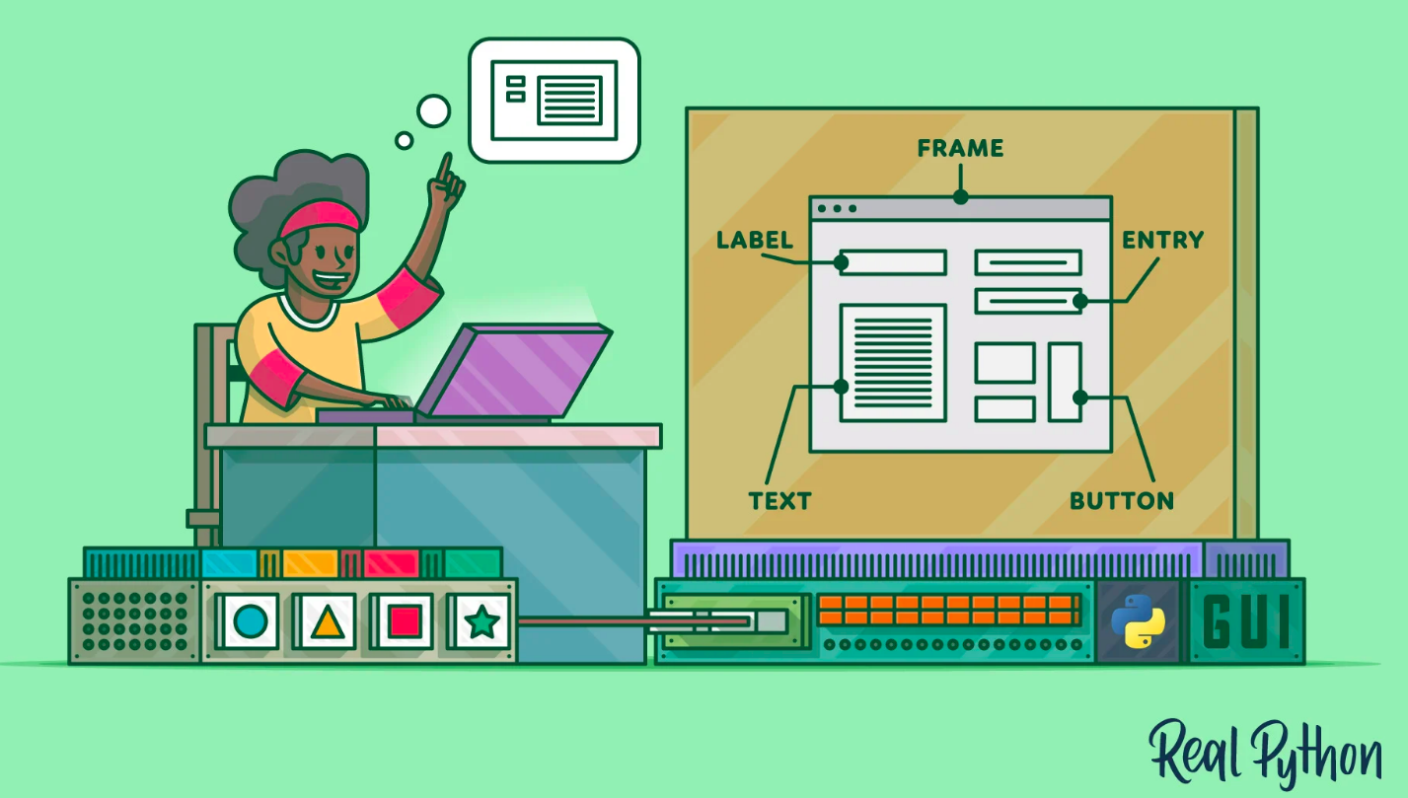

Slide 11
Widgets

Slide 12
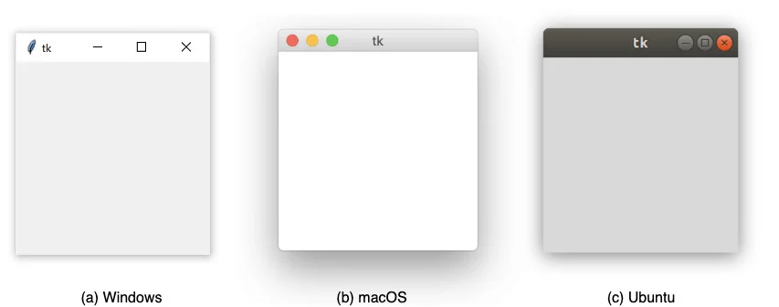
Windows

Slide 13
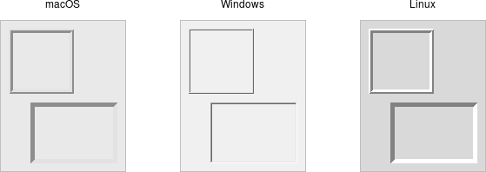
Frame
help to organize your user interface
Source: https://tkdocs.com/tutorial/widgets.html

Slide 14
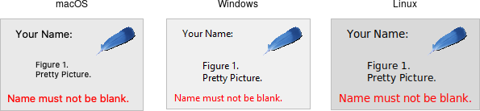
Label
displays text or images (no interaction)
Source: https://tkdocs.com/tutorial/widgets.html

Slide 15
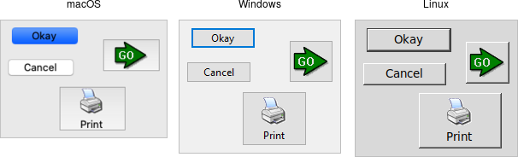
Button
press a button to perform an action
Source: https://tkdocs.com/tutorial/widgets.html

Slide 16
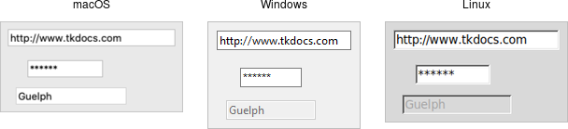
Entry
single-line text field
Source: https://tkdocs.com/tutorial/widgets.html

Slide 17
Graphical User Interfaces (GUIs)

Slide 18
Graphical User Interfaces (GUIs)

Slide 19
Graphical User Interfaces (GUIs)

Slide 20
Graphical User Interfaces (GUIs)

Slide 21


Slide 22

Executable files

Slide 23

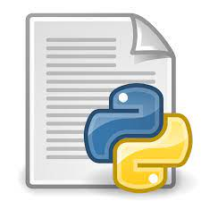
Executable files

Slide 24


Executable files

Slide 25


Executable files

Slide 26
Executable files
Executables are platform-specific
They can be made for either Windows, Mac OS or Linux platforms
So several versions are needed
You can usually only build executables for a specific platform on a machine with the same (kind of) operating system

Slide 27
Executable files
There are different frameworks available to generate executables for Python programs
PyInstaller
Windows, Mac OS and Linux
Support for (recent) Python versions
https://pyinstaller.readthedocs.io/en/stable/ for instructions

Slide 28
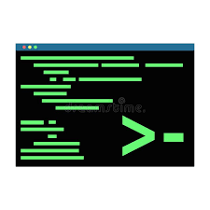

Slide 29
To Do
Exercises for the week
  Use quarterfall to submit them
Work in Project 4

